Slide 1
Navigating the Debt Crisis: Strategies for Managing and Reducing Student Debt in Higher Education
ITS Integrator User Group
7 March 2025
Notes:
Story – The wheelbarrow by J.JOHN: Bigger picture – Alternative funding models and leveraging technologies (instead of narrow mind – collecting!)

Slide 2
Why Students Invest in Education Despite Rising Costs
Education as a Driver of Economic and Social Progress
Education enhances employability and income potential.
It contributes to national economic growth and social mobility.
Human Capital Theory
Education is an investment that yields long-term financial benefits.
Higher academic achievements often lead to higher salary expectations.
Global Perspectives on Education & Employment
SDG 4 emphasizes equitable access to quality education.
In China, education is a key determinant of economic success and social mobility.
In Russia, students expect higher salaries based on their educational investments.
Notes:
"Education is the most powerful weapon you can use to change the world“ Mandela Education plays a dual role—improving individual success while driving broader economic progress.
Human Capital Theory suggests that education is an investment that enhances employability and earning potential.
The importance of education extends globally—examples from China and Russia show that students view education as a pathway to economic success.
Despite high tuition costs, many students pursue education due to its long-term financial benefits and social mobility potential.

Slide 3
Global Perspectives on Student Debt
Government funding cuts led to higher tuition fees and an alarming $1.3 trillion student debt affecting 44.2 million people.
Despite free tuition, preparation and other costs create financial strain for families.
Limits non-paying students via admission quotas but has no cap on tuition-fee paying students
Annual student loans amount to £20 billion, with outstanding loans expected to reach £500 billion by the 2040s
Australia pioneered income-contingent loans (ICLs) in 1989, later adopted by Brazil, Colombia, and Japan.

Slide 4
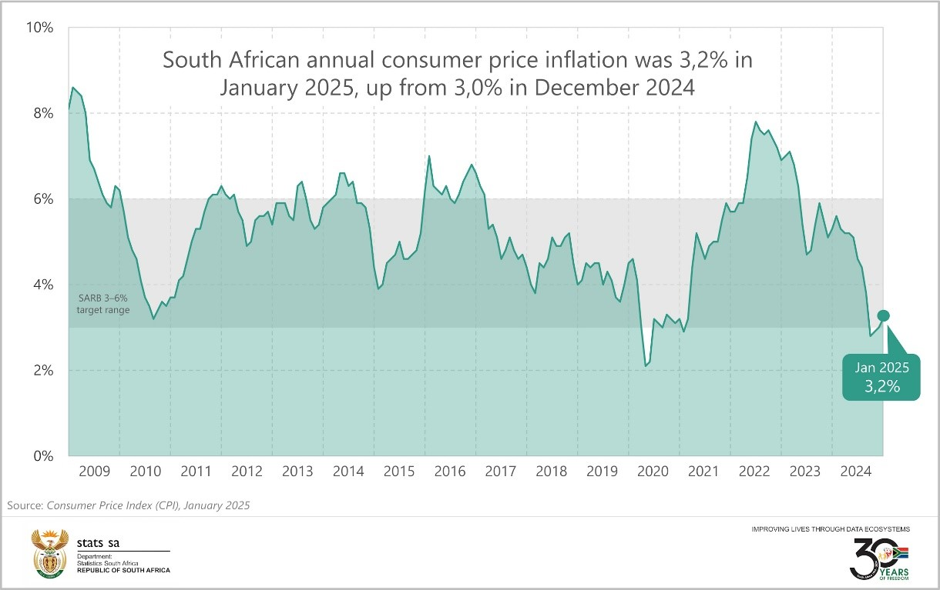
The Student Debt Landscape in South Africa
Government funding
Learning and Culture, made up 20.28% of the R2.37 trillion total government expenditure for #2024Budget (R137.5 billion budget for 2024/25 for DHET and R53.6 for NSFAS), yet student debt persists.
Socioeconomic factors
Students from low-income households cannot afford tuition and living expenses.
Economic factors
Economic factors such as high unemployment rates (32.1%), high inflation (3,2%), and exorbitant interest rates (11%) contribute to challenges in repaying student debt.
Education accounts for only 2% of total household spending.
Commercialization of Education
Higher education prioritizes institutional financial stability over affordability for students.
Viewing students as consumers in higher education has contributed to increasing education costs and student debt.

Slide 5
UJ Strategies for Managing and Reducing Student Debt
The People
The Policy
The Processes
The Systems
iEnabler Acknowledgment of Debt.
Pre-Handover System.
Third-Party Integration.
A team led by Senior Director, Director, and four Senior Managers.
Early debt handovers improve recovery.
Blocking Academic Results.
Legal Summons.
Settlement Discount Incentives.
Fundraising & Donor Engagement.
Payment Arrangements.
Debts older than three years are written off.
Students with written-off debts are barred from re-registration until settled.
Outstanding debts of non-registered students are handed-over to external collectors.
Enforcing varying upfront payments.
Student Finance Systems team for automation and efficiency.

Slide 6
The Future: AI and Data-Driven Solutions
AI-Driven Technologies & Decision Support Systems
AI enhances efficiency in financial aid management.
Machine Learning to enable predictive analytics for better allocation of resources.
AI and DSS to improve transparency and efficiency.
Optimizing Financial Aid with Data-Driven Decision-Making
Algorithmic decision-making to predict future financial aid needs.
Data insights to help refine financial support strategies and student debt management.

